Slide 1
Movie Recommender Delivering personalized content to increase user engagement and retention

Slide 2
Project analysis slide 2
Project Analysis
INTRODUCTION
DATA PROCESSING
PROJECT
CONCLUSION
VISUALIZATION
MODEL EVALUATION
MODELLING

Slide 3
Project analysis slide 3
Introduction
The Movie Recommender System aims to solve a significant problem in the streaming industry—choice paralysis. With an ever-growing library of content, users often find themselves overwhelmed by the sheer volume of available options, spending excessive time searching rather than watching.

Slide 4
Project analysis slide 3
Business Problem
Users struggle to find content they want to watch, resulting in disengagement and increased churn.
7+ minutes spent searching per session
48% of users report feeling overwhelmed by content options
This leads to user drop-off, which negatively impacts platform revenue and user retention.
Objectives
Reduce User Churn
Enhance User Engagement
Improve Content Discovery and Satisfaction

Slide 5
Project analysis slide 3
Dataset Overview
The Datasets used for the recommender system is rich with metadata crucial to the implementation of the recomme
Movies: 9,742 entries with titles, genres, and release years
Ratings: User-movie interactions on 5-point scale
Tags: User-generated descriptors enhancing recommendations
Links: Connections to external movie databases
Data Limitations
Older ratings may not reflect current preferences
Cold start problem
Missing context such as day, device and mood is not captured
Limited demographic data

Slide 6
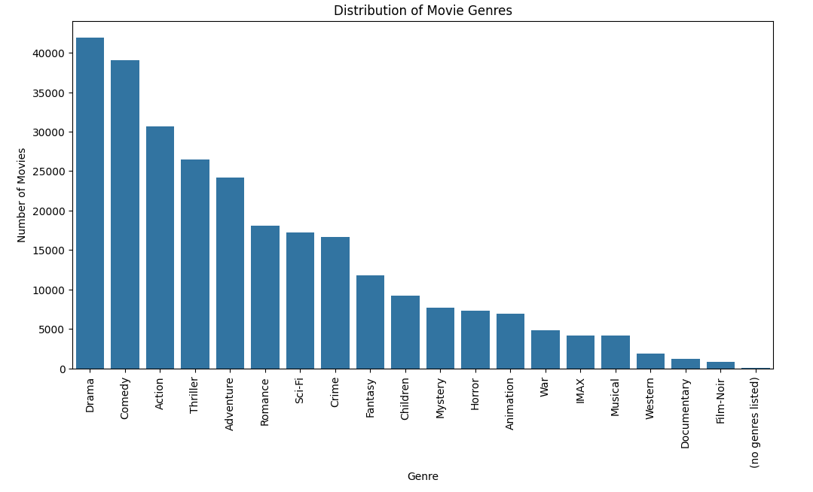
Project analysis slide 3
Data Analysis
and Visualization
The top 3 genres with the highest number of movies are :
Drama, Comedy and Action

Slide 7
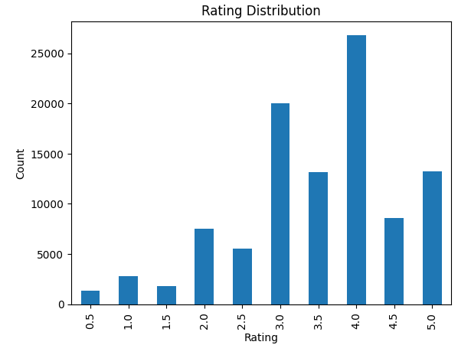
Project analysis slide 3
Data Analysis
and Visualization
Users tend to rate movies more positively than negatively(3-4 stars) Indicating either a general satisfaction with the movies being rated or a tendency for users to rate things they like more often than things they dislike.

Slide 8
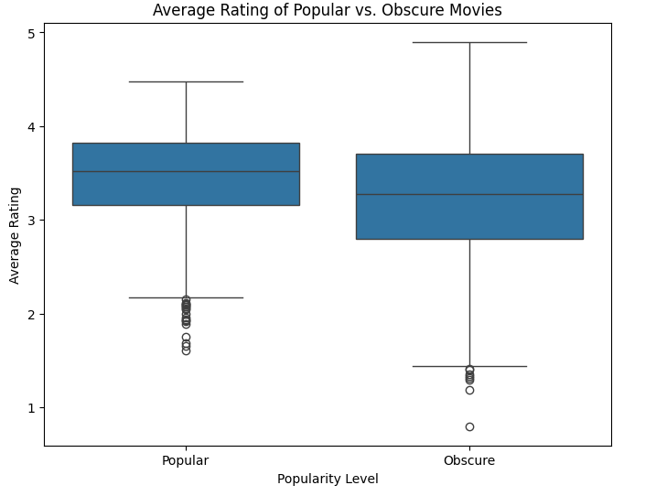
Project analysis slide 3
Data Analysis
and Visualization
While popular and obscure movies have similar typical ratings, there are some differences in their rating distributions, particularly in the outliers and overall range

Slide 9
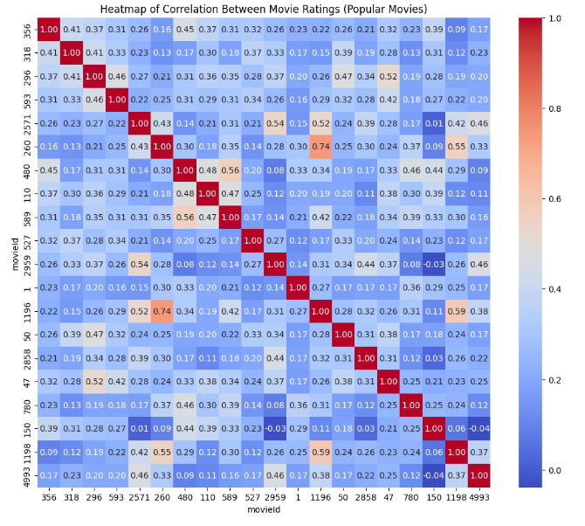
Project analysis slide 3
Data Analysis
and Visualization
The data shows people tend to rate movies positively, and there are patterns in which movies appeal to the same viewers.
Most movies get good ratings (around 3-4 out of 5)
Popular and obscure movies are rated similarly overall

Slide 10
Project analysis slide 3
Modelling
Collaborative Filtering - Matrix Factorization (SVD)
Collaborative Filtering uses user behavior to recommend content based on similarities between users.
Matrix Factorization (SVD) decomposes the user-item rating matrix into latent factors to predict ratings for unrated movies.
SVD algorithm with 100 latent factors was used, with an Improved RMSE to 0.86 (18% improvement over baseline)
Example Recommendations for User 1:
- City of Lost Children, The (Cité des enfants perdus, La) (1995) (Predicted rating: 5.00)
- Hoop Dreams (1994) (Predicted rating: 5.00)
- Shawshank Redemption, The (1994) (Predicted rating: 5.00)
- Wallace & Gromit: A Close Shave (1995) (Predicted rating: 5.00)
- Trainspotting (1996) (Predicted rating: 5.00)

Slide 11
Project analysis slide 3
Modelling
Content-Based Filtering (Using Movie Metadata)
Content-Based Filtering recommends movies based on similarity of movie features, such as genres.
TF-IDF (Term Frequency-Inverse Document Frequency) is used to transform genres into numerical features to compute similarity between movies.
Example Recommendations for "Toy Story (1995)":
Antz (1998)
Toy Story 2 (1999)
Adventures of Rocky and Bullwinkle, The (2000)
Emperor's New Groove, The (2000)
Monsters, Inc. (2001)

Slide 12
Project analysis slide 3
Modelling
Hybrid Models (Collaborative + Content-Based Filtering)
Hybrid models combine the strengths of Collaborative Filtering and Content-Based Filtering to provide more accurate and diverse recommendations.
Example Recommendations for User 1
Shawshank Redemption (1994)
Lion King, The (1994)
In the Name of the Father (1993)
Blade Runner (1982)
Wallace & Gromit: The Best of Aardman Animation (1996)

Slide 13
Project analysis slide 3
Modelling
Hybrid Models (Collaborative + Content-Based Filtering)
Hybrid models combine the strengths of Collaborative Filtering and Content-Based Filtering to provide more accurate and diverse recommendations.
Example Recommendations for User 1
Shawshank Redemption (1994)
Lion King, The (1994)
In the Name of the Father (1993)
Blade Runner (1982)
Wallace & Gromit: The Best of Aardman Animation (1996)

Slide 14
Project analysis slide 3
Model Evaluation
Model Evaluation using RMSE
RMSE: Penalizes large prediction errors that lead to poor recommendations. This is critical since bad recommendations damage user trust.
Model Evaluation using MAE
MAE: Measures average error magnitude for business reporting
Final Model Performance:
Our hybrid model achieved a low RMSE (0.8577), which means it predicts ratings accurately, similar to top models like those in the Netflix Prize
The MAE (0.6587) shows that our predictions are only off by about 0.66 stars on average—making our recommendations highly reliable.
Therefore implementing the hybrid approach increase content exploration is the best fit for the recommender system

Slide 15
Project analysis slide 3
Conclusion
Key Achievements:
Developed a highly accurate hybrid recommendation system that combines collaborative and content-based filtering for personalized movie suggestions.
Our model demonstrates improved prediction accuracy, greater content diversity, and significantly reduces the cold-start problem for new users and movies.
Next Steps:
Deploy the recommendation system on the platform and continue monitoring user engagement.
Explore contextual recommendations by integrating factors like time of day and device.
Expand the model to include additional user behaviors, such as rewatch rates and watch duration, for even more tailored suggestions.

Slide 16
Questions

Slide 17
Thank You
Brenda Chamutai
Anthony Odhiambo
Evans Makau
Christin Kindena
John Mugambi

